Slide 1
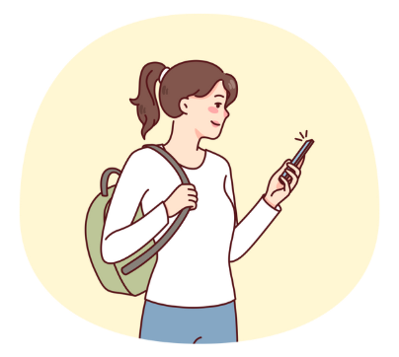
_Calm Space_
Social Media Addiction & Student Conflicts
Survey Insights Q1 2025
“High screen time, low sleep, higher conflict risk.”
Mikhael Putra Iswanto
RevoU - FSDA Madrid batch JUN25
Source Collab Tableau Slide

Slide 2
_Calm Space_
Summary Executive
1 Problem
2 Objective
Within 6 months, Calm Space aims to cut student conflicts from social media by 15% by improving sleep (+30 minutes) and reducing anxiety
To cut student conflicts from social media by 15% by improving sleep (+30 minutes) and reducing anxiety in Q2 2025
3 Key Metrics
4 Tools
Avg_Daily_Usage_Hours, Sleep_Hours_Per_Night, Conflicts_Over_Social_Media, Mental_Health_Score.
Google Slide, Python, Tableau
5 Findings
6 Recommendation
Student have high prevalence of conflict and Lack of sleep & anxiety
To deploy strategic to take action in Q2 2025.

Slide 3


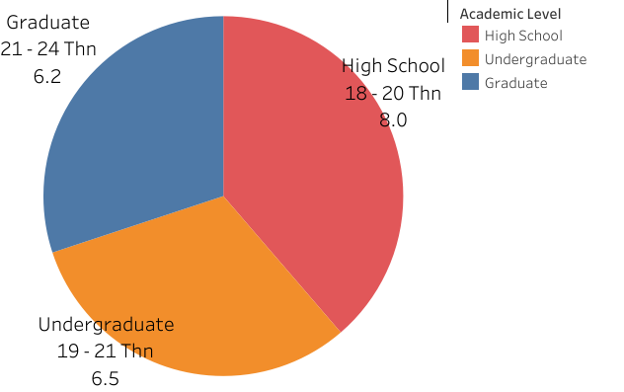
_Calm Space_
Industry Model & Business Processes
An B2B SaaS EdTech company focuses on student well-being and engagement through a platform that monitors social media usage, sleep patterns, and potential conflicts. The platform also provides data-driven interventions to support mental health and academic performance.
Primary revenue comes from annual licenses offered and additional revenue through professional consulting and premium analytics packages.
> Stakeholder Analysis
(Approver)
Head of Data & Research
(Responsible)
Data Analyst
Decision Maker - CEO
Consulted - Psikolog, Teacher Advisor Informed - School board, All teaching staff, students
1
2
3
4
5
6

Slide 4
_Calm Space_
> Objective
⚡ Reduce interpersonal conflicts down 15%.
😴 Increase average sleep +30 minutes/night.
😟 Lower self-reported anxiety levels.
“Within 6 months, Calm Space aims to reduce incidents of interpersonal conflict among students due to excessive social media use by 15%, by increasing average sleep quality by more than 30 minutes per night and lowering self-reported anxiety levels.”
Focus on screen time, sleep, conflict, mental health student.
Business Problem & Objective
> Business Problem
> Project Scope
1
2
3
4
5
6

Slide 5
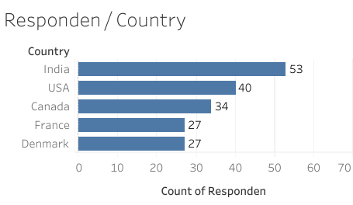
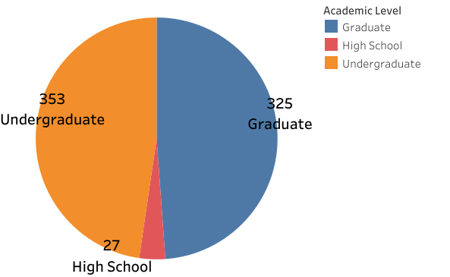
_Calm Space_
Source: Kaggle survey dataset (705 respondents, 5 continents, 101 Country).
Demographic coverage: High school, undergraduate, graduate students.
Key Metrics variables:
Screen Time (daily usage, platform, addiction score).
Sleep (hours/night).
Mental Health (anxiety/score).
Conflicts (relationship & social conflict reports).
Note: Data is cross-sectional & survey-based (not causal).
Dataset Overview
1
2
3
4
5
6

Slide 6
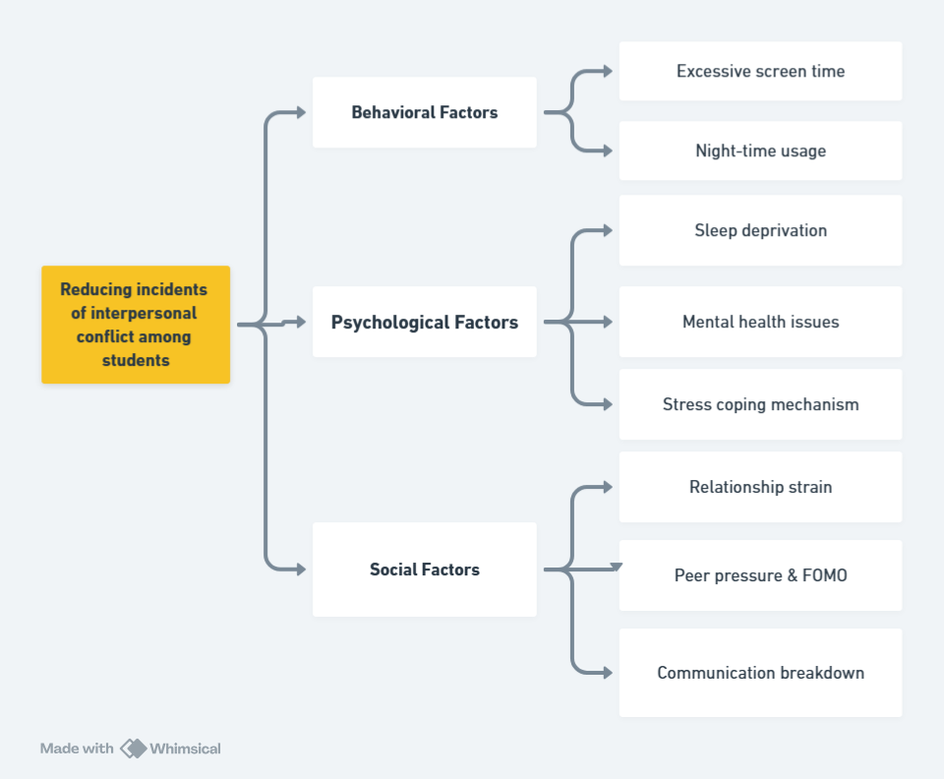
_Calm Space_
Student who use social media more than 5 hours/day have risk of interpersonal conflict that is twice as high as student who use social media for less than 3 hours/day.
Students who sleep less than 6 hours/day tend to have anxiety/depression scores that are 25% higher than those who sleep 7 hours or more per day.
The Combination high screen time (>5hours/day) & short sleep (<6hours/day) increases risk of interpersonality conflict 2 times compared with low screen time & enough sleep.
Analysis Framework
> Root Causes Analysis
> Hypothesis
1
2
3
4
5
6

Slide 7
_Calm Space_
Methodology
1
Defining
the problem
2
Data cleaning & preparation
3
Exploratory data analysis
4
Analysis Framework
5
Insights & recommendation
Exploratory and understand data and problem
Determine the user using DARCI
Define Objective
Data cleaning & preparation using Python
EDA using python, & Visualization using tableau
Correlations & segmentation by academic level / relationship status.
Summary of the remarkable insights & Recommendations
1
2
3
4
5
6

Slide 8
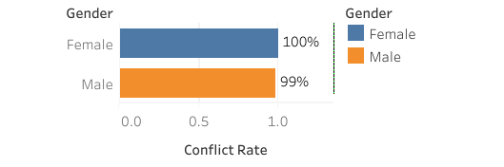
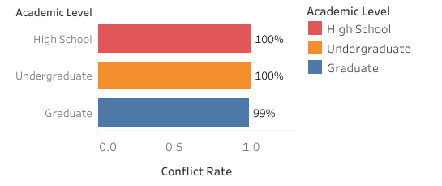
_Calm Space_
Almost all students reported conflicts due to social media.
Not linked to gender (male vs female similar conflict rates).
Education level: graduate students slightly better, but conflict still significant.
Conflict is Systematic
> Conflict: A Systematic Issue
“Conflict is widespread, not isolated.”
1
2
3
4
5
6

Slide 9
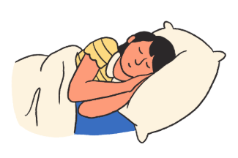
_Calm Space_
“The World Health Organization (WHO) does not specify a particular “international sleep time,” but recommends different sleep durations for different age groups. For adults (18–64 years old), 7–9 hours of sleep per night is recommended, while adolescents (14–17 years old) need 8–10 hours of sleep. Less than these durations can have a negative impact on health and daily performance.”
nhlbi - 2022
Sleep as a Key Mediator
1
2
3
4
5
6

Slide 10
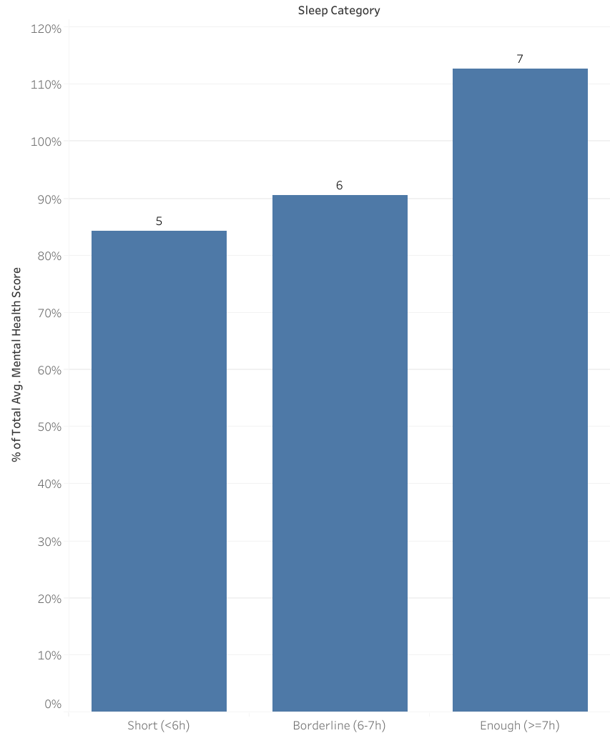
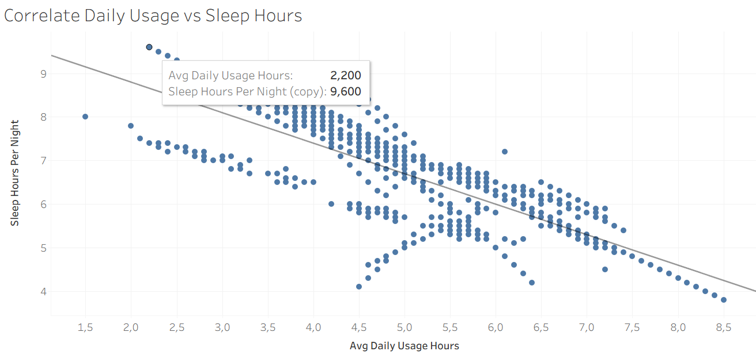
_Calm Space_
<6 hours of sleep is associated with the lowest mental health scores (–85%).
7 hours of sleep supports better health (+113%).
A clear negative correlation: the more time spent in front of a screen, the less sleep.
113%
Sleep as a Key Mediator
85%
> Sleep Duration & Mental Health
“High screen time = short sleep.”
1
2
3
4
5
6

Slide 11
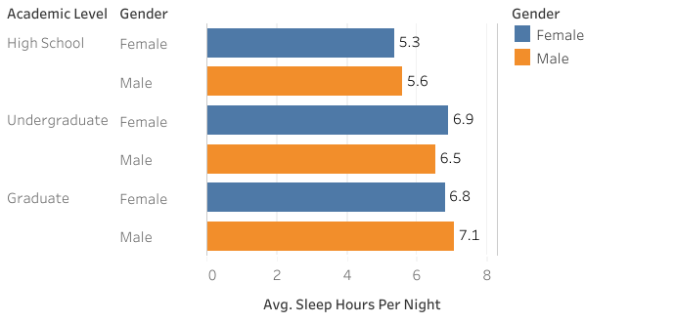
_Calm Space_
There is an pattern increase in hours of sleep as the level of education increases.
High school students show the highest potential for sleep deprivation, sleeping less than 6 hours.
Graduate students have the highest average number of hours of sleep, with males sleeping slightly longer than females.
Sleep as a Key Mediator
> Sleep Duration Sleep Duration
based on academic performance
1
2
3
4
5
6

Slide 12

_Calm Space_
“The average screen time for adults (aged 16 to 64) is 6 hours and 37 minutes per day.”
Digital Report 2023
Duration Screen time Usage
1
2
3
4
5
6

Slide 13
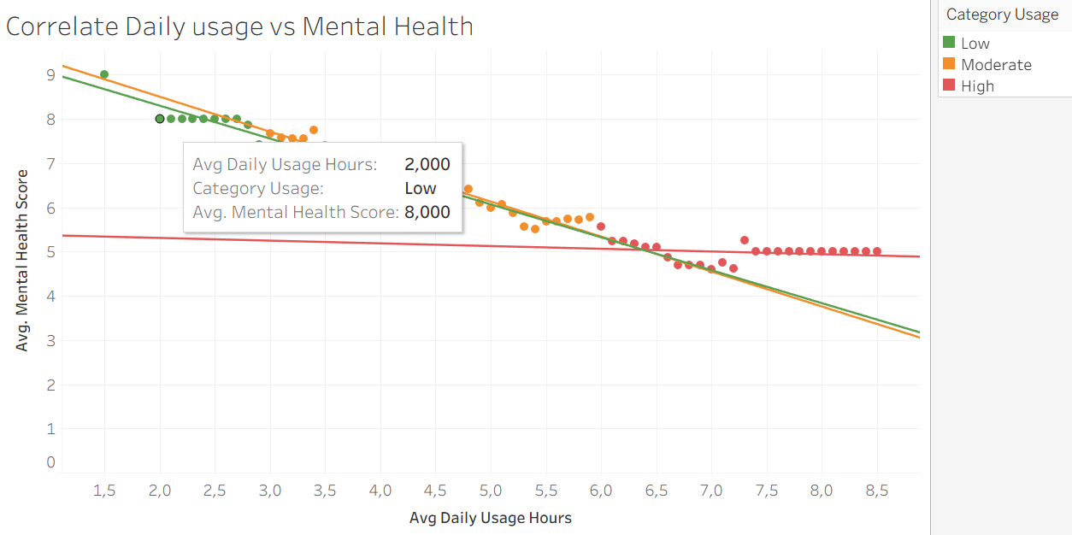
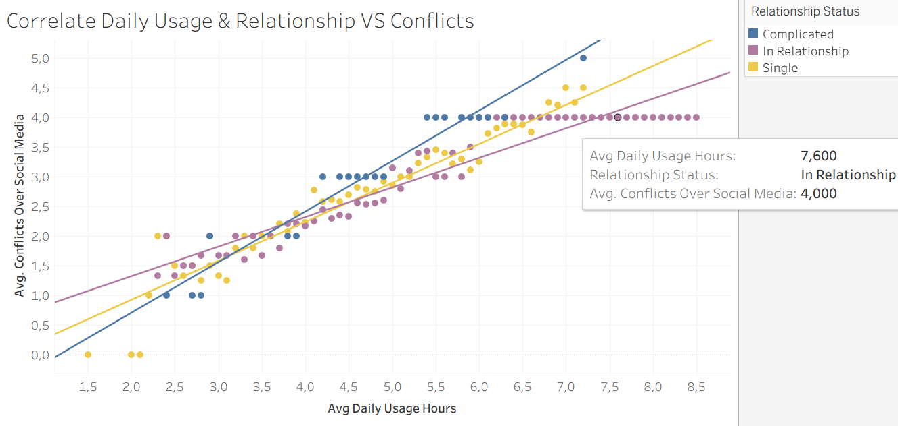
_Calm Space_
Duration Screen time Usage
1
2
3
4
5
6

Slide 14
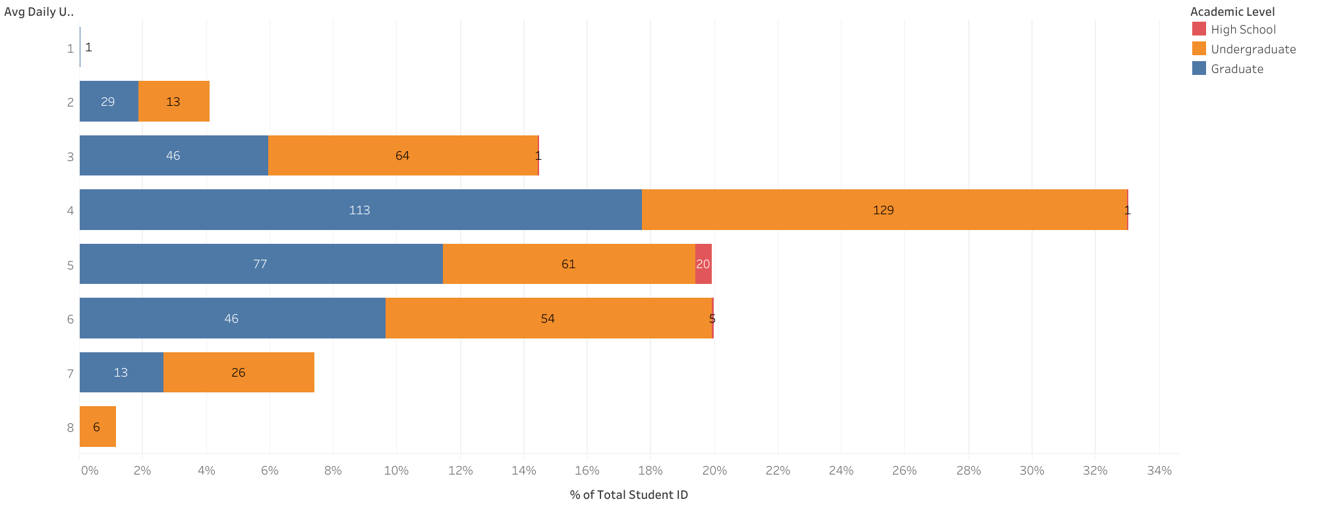
_Calm Space_
Dominate usage for 4-6 hours per day.
Undergraduates most intensively on a daily basis, with some even reaching 8 hours per day.
Graduate students are relatively balanced (3-6 hours) and rarely exceed 7 hours per day.
High school students use social media less, but still significantly, up to 5 hours per day.
Duration Screen time Usage
> Daily Usage per Academic
1
2
3
4
5
6

Slide 15
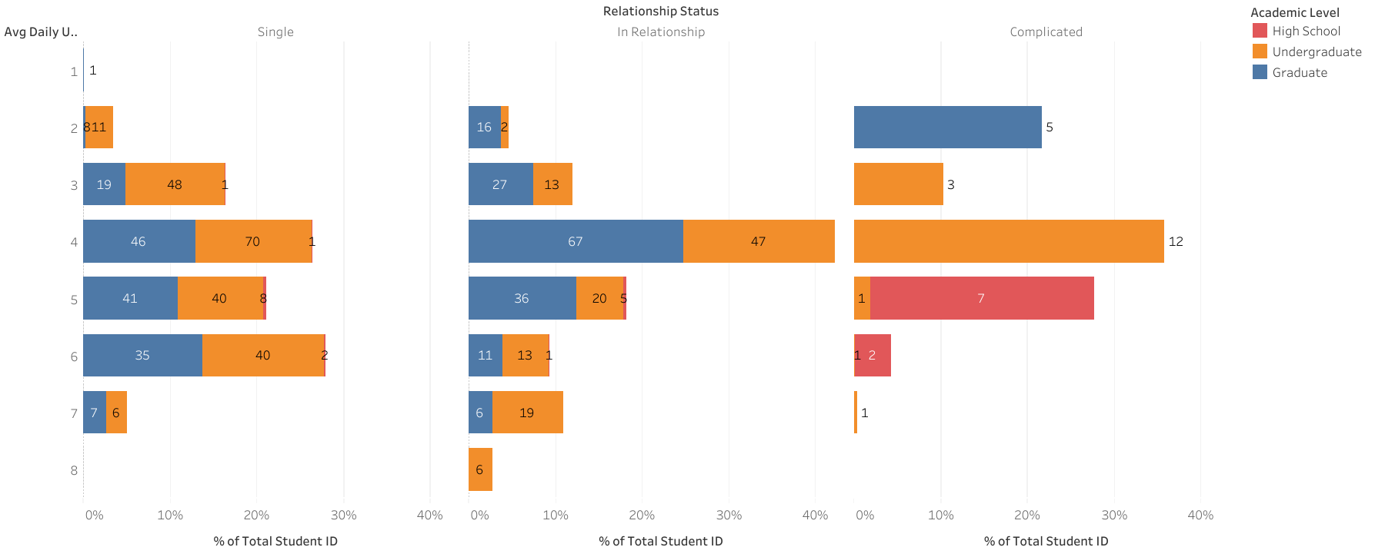
_Calm Space_
Undergraduates are heaviest users (4–8h/day).
Single/Complicated status more extreme screen time.
Moderate users (3–5h/day) paradoxically most conflict-prone (more active interactions).
Who is Most at Risk?
> High-Risk Student Groups
“Undergraduates (single/complicated) are most vulnerable.”
1
2
3
4
5
6

Slide 16
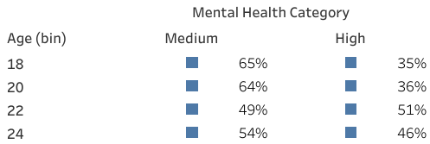
_Calm Space_
The average mental health score of respondents was in the medium category.
The highest mental health score was among those aged 22, and the lowest was among those aged 18–20.
As age increased, mental health scores also increased.
Segmentation Mental Health
> level of anxiety based on age
1
2
3
4
5
6

Slide 17
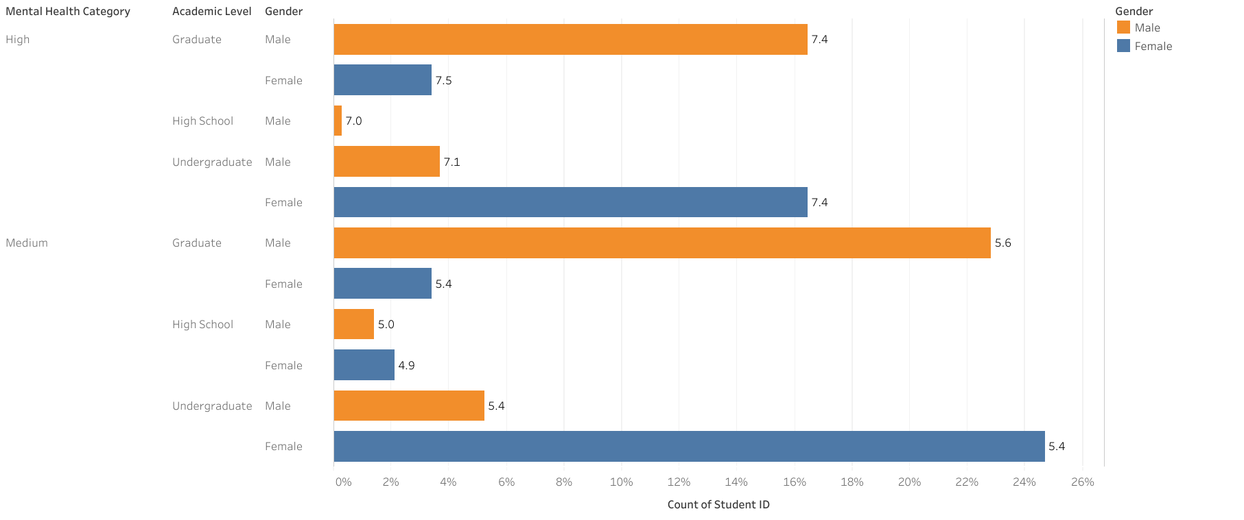
_Calm Space_
Women tend to have higher scores than men, except at the undergraduate level.
High levels of anxiety were seen at all levels of education, especially at the undergraduate and graduate levels.
There were few high school respondents, but those who reported high scores reached 7.0–7.1.
Segmentation Mental Health
> level of anxiety based on Gender & Academic
1
2
3
4
5
6

Slide 18
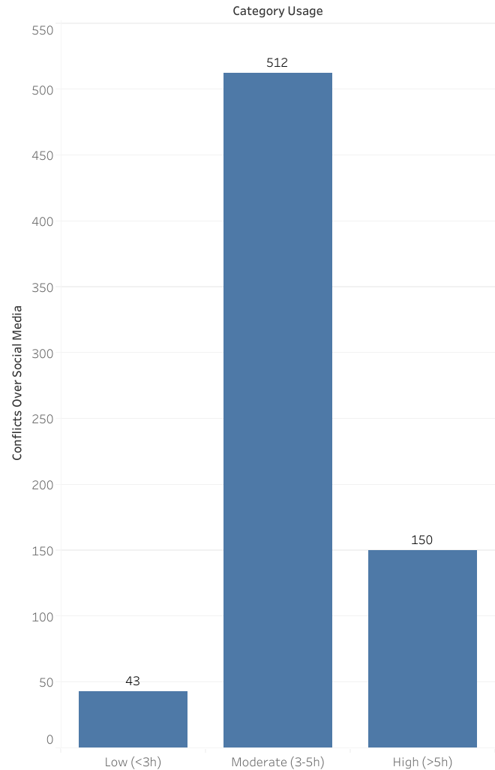
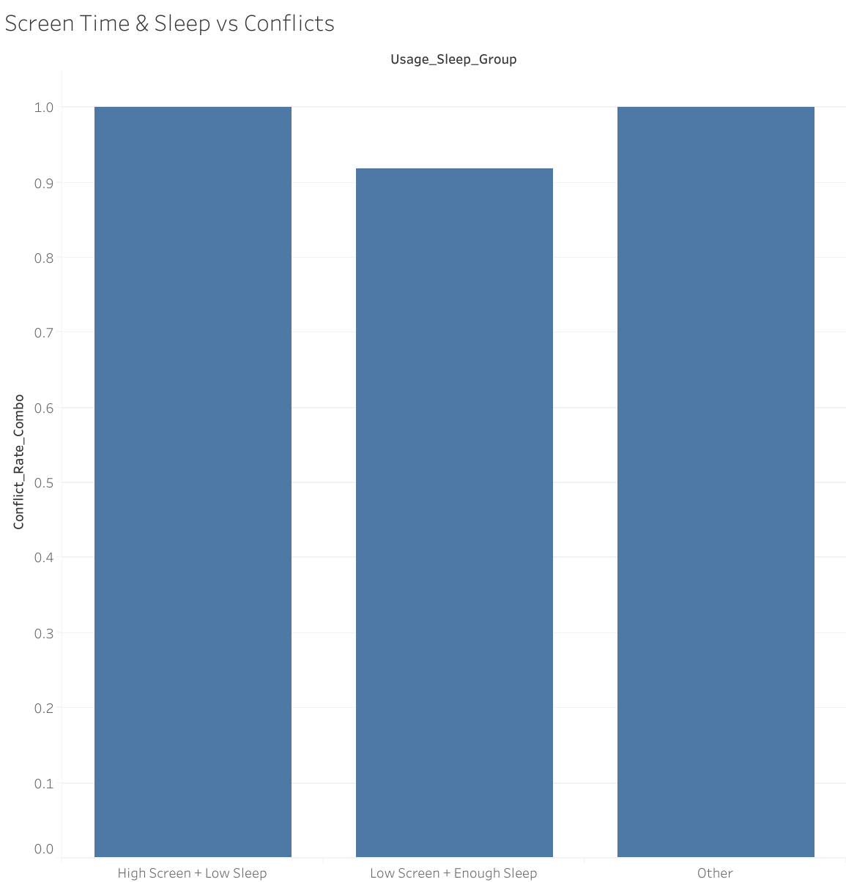
_Calm Space_
High Students using >5h/day (150)
2x higher conflict risk vs <3h/day (43).
Students sleeping <6h/night
25% higher anxiety vs ≥7h .
Combination (>5h Timescreen + <6h sleep) 2x conflict risk vs balanced group.
Hypotheses Validated
> Hypotheses Confirmed by Data
113%
85%
✅
✅
✅
1
2
3
4
5
6

Slide 19


_Calm Space_
High prevalence of conflict risk of decline in academic achievement and student welfare.
Lack of sleep & anxiety increased need for counseling services (increased institutional costs).
Undergraduate students are vulnerable main target of Calm Space (potential market & early intervention).
If left unaddressed school/university reputation may decline (dropouts, exhaustion, complaints).
Business Insight
> Business Impact: Why This Matters
⚡
😴
😟
🎓
1
2
3
4
5
6

Slide 20
_Calm Space_
Focus: reduce student conflicts by 15% through better sleep & screen time balance.
Target Group: Undergraduates with single/complicated relationship status = most at risk.
Actions:
Launch Sleep First Campaign to encourage +30 min average sleep.
Deploy Gamified Digital Detox Challenge (reward for <5h/day).
Provide Institutional Wellness Dashboards to school boards/universities.
Expected KPI Impact: Conflict down15%, Sleep +30 min, Anxiety down 10%.
Strategic Recommendations (Q2 2025)
> Strategic Actions for Q2 2025
🎯
🏫
⚡
📊
1
2
3
4
5
6

Slide 21
_Calm Space_
Objective, Reduce student conflicts by 15% in 6 months by improving sleep (+30 min/night) and reducing anxiety.
Summary Insight & Recommendation
> Strategic Actions for Q2 2025
B (Business Problem) | P (Insight Summary) | I (Recommendation – Detailed & Actionable) | R (Priority Level)
Students show high conflict prevalence linked with excessive screen time and poor sleep. | Conflicts are systematic (seen across gender & education level), with undergraduates most vulnerable. | 🎯 Target undergraduates with “single/complicated” status through digital wellness programs (screen time balance, sleep campaign). | 🔴 High
Excessive screen time (>5h/day) doubles conflict risk. | Undergraduates dominate usage (4-8h/day). Moderate users (3-5h/day) most conflict-prone due to active interactions. | ⚡ Launch Gamified Digital Detox Challenge to reward <5h/day usage; integrate screen time tracker in Calm Space app. | 🔴 High
Poor sleep (<6h/day) raises anxiety/depression by 25%. | High school students most at risk of sleep deprivation (<6h), graduate students have better patterns. | 🌙 Deploy Sleep First Campaign: nudges for 7h sleep, bedtime reminders, sleep score dashboard for schools. | 🟠 Medium
1
2
3
4
5
6

Slide 22
_Calm Space_
Objective, Reduce student conflicts by 15% in 6 months by improving sleep (+30 min/night) and reducing anxiety.
Summary Insight & Recommendation
> Strategic Actions for Q2 2025
B (Business Problem) | P (Insight Summary) | I (Recommendation – Detailed & Actionable) | R (Priority Level)
Combined high screen time + poor sleep doubles conflict risk. | Groups with irregular patterns are most vulnerable to conflict. | 🧩 Build Conflict Risk Score Model combining screen time + sleep alerts for at-risk students. | 🔴 High
Anxiety levels remain high across education levels, especially undergraduate & graduate. | Women slightly higher scores, except undergrad; mental health lowest at age 18–20. | 🧑‍🏫 Partner with psychologists & schools to run micro-courses on stress management, healthy digital interaction, targeting 18–22 age. | 🟠 Medium
Country variation: US & India high usage, but conflict also high in Bangladesh & Pakistan even at lower usage. | Conflict not linear with usage; cultural/contextual factors matter. | 🌍 Expand Calm Space B2B offering to universities in high-conflict regions, tailor interventions per region. | 🟡 Low (longer-term)
1
2
3
4
5
6

Slide 23
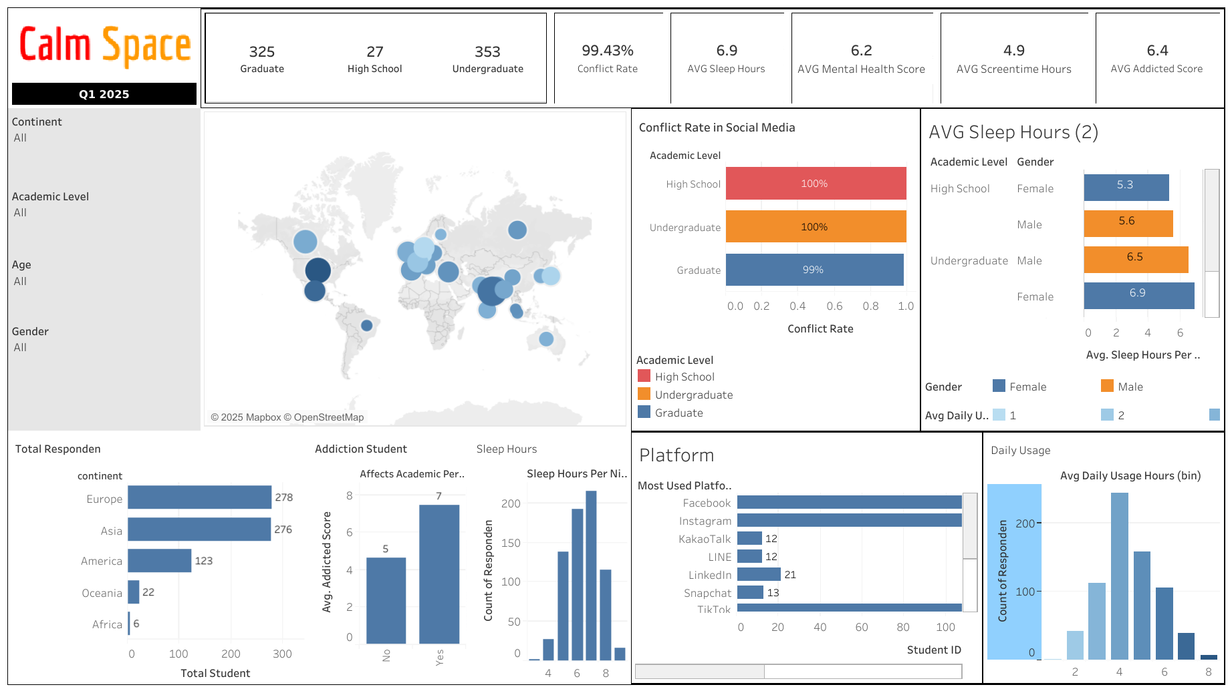
_Calm Space_
Dashboard

Slide 24
QnA

Slide 25
Thank You
Social Media Addiction & Student Conflicts : Survey Insights from Q1 2025
Mikhael Putra Iswanto
RevoU - FSDA Madrid batch JUN25
Source Collab Tableau Slide

Slide 26
APPENDIX
Link Python

Slide 27
Correlation
Excessive social media use (more than 5 hours/day) is strongly correlated with poorer mental health.
The most significant impact is seen among low and moderate users, while high users are already at a low point and do not deteriorate much further.
Positive correlation: the higher the daily use of social media, the higher the conflict on social media
Relationship status is related to this correlation, with the highest conflict occurring among those with a “Complicated” status, followed by “Single,” and the lowest among those “in a relationship”.

Slide 28
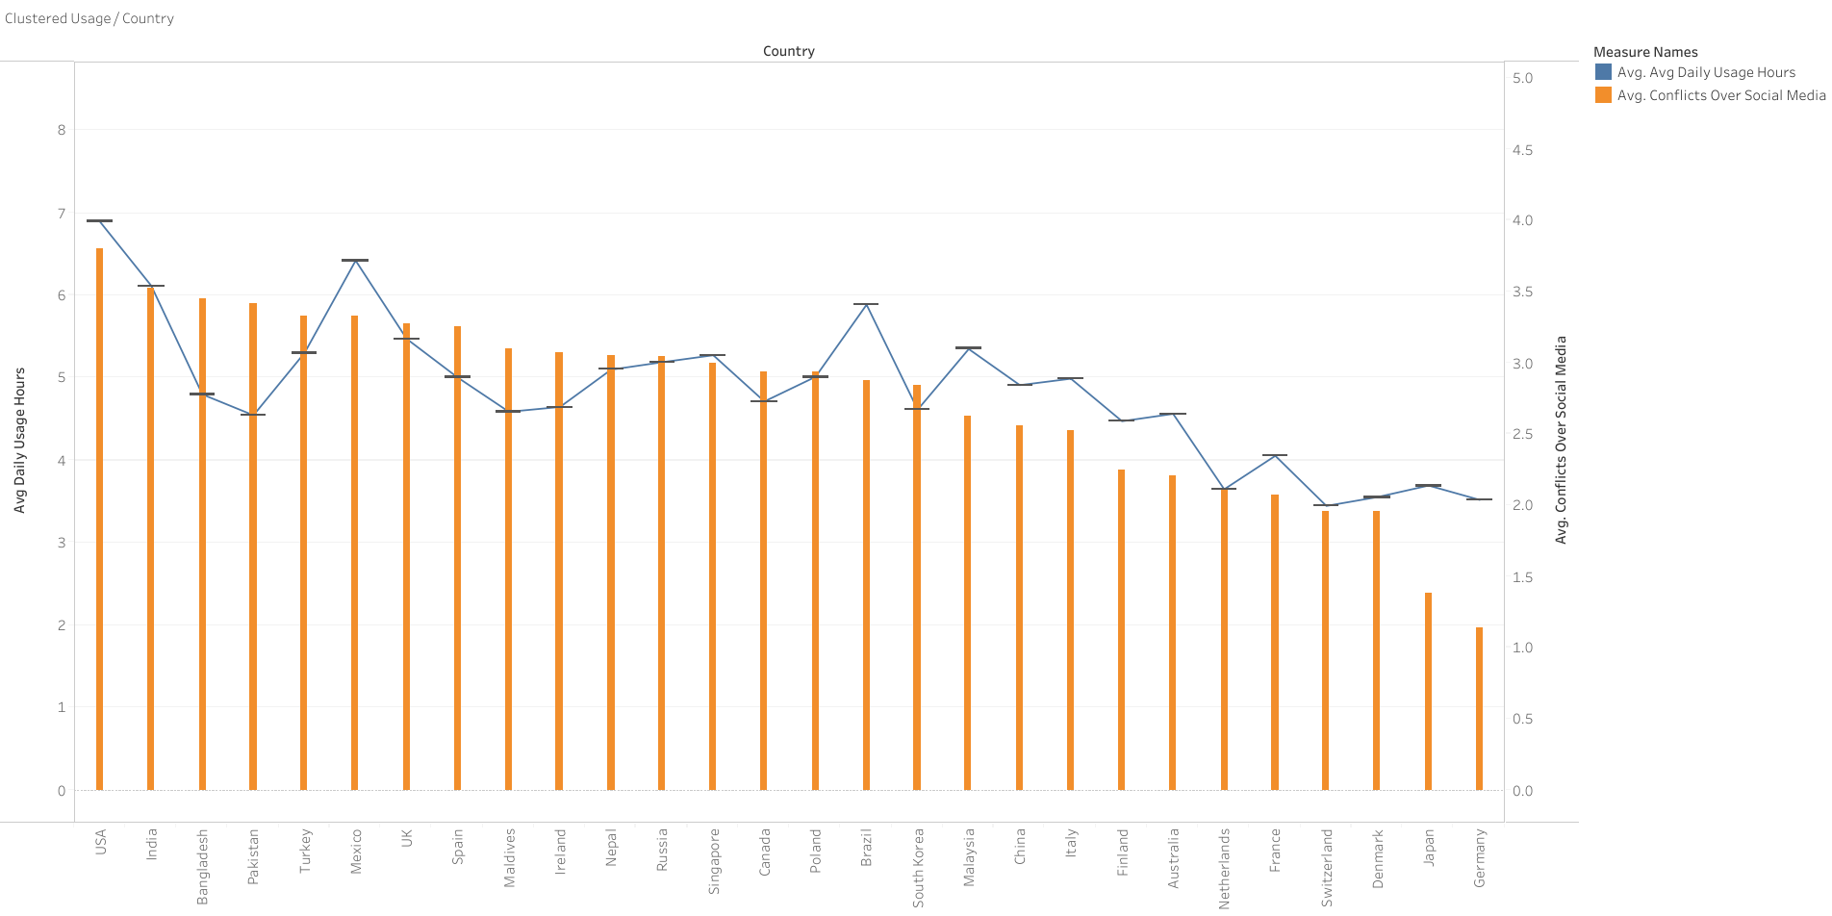
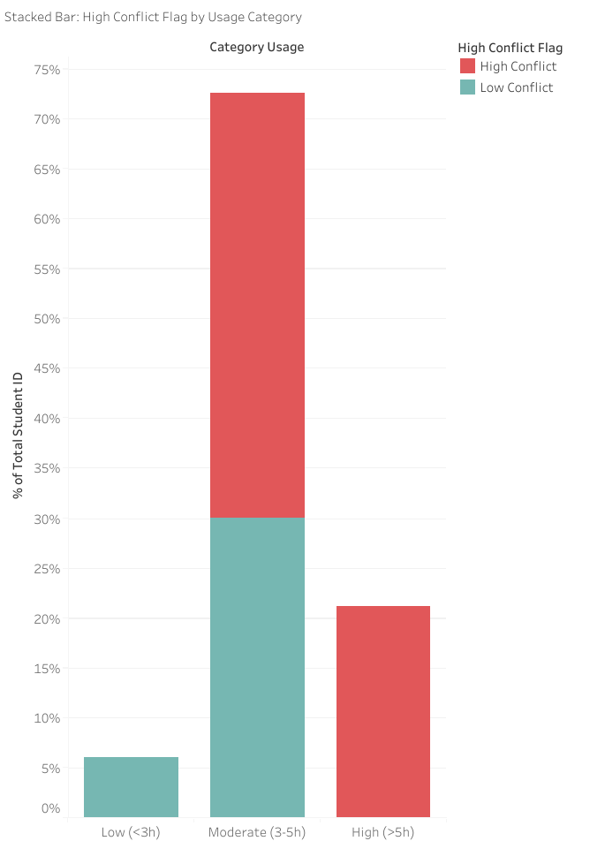
Results Average Daily Usage per Country
The USA and India have the highest daily social media usage (>6 hours/day), but high usage does not always correlate linearly with conflict.
For example, Bangladesh and Pakistan have relatively lower usage hours than the USA, but the resulting conflict is quite high.
The majority of interactions on social media trigger high conflict (>3). This indicates a high potential for negative impacts on mental health, especially in countries with high usage hours.
The higher the usage, the higher the conflicts
The majority of respondents were not low users, but moderate/high users, and more than half had been affected by the conflict.

Slide 29
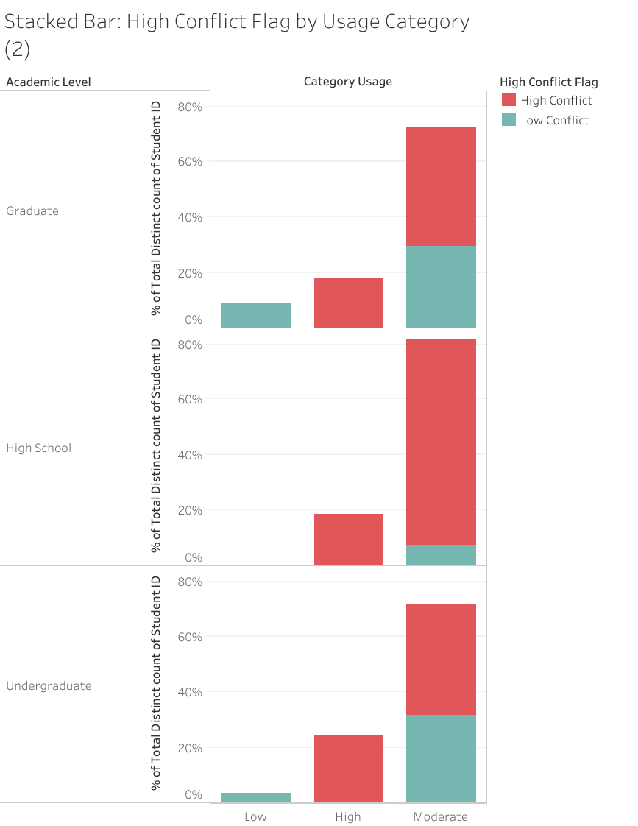
Results by Academic Level
In the first quarter, social media addiction among university and high school students was high and led to social conflicts
High school students were the respondents most affected by high conflict, even at moderate usage levels.
Undergraduate conflict was high at high usage levels, but more balanced at moderate usage levels.
Graduate conflict was still significant, but more controlled than at the high school level.

